Slide 1
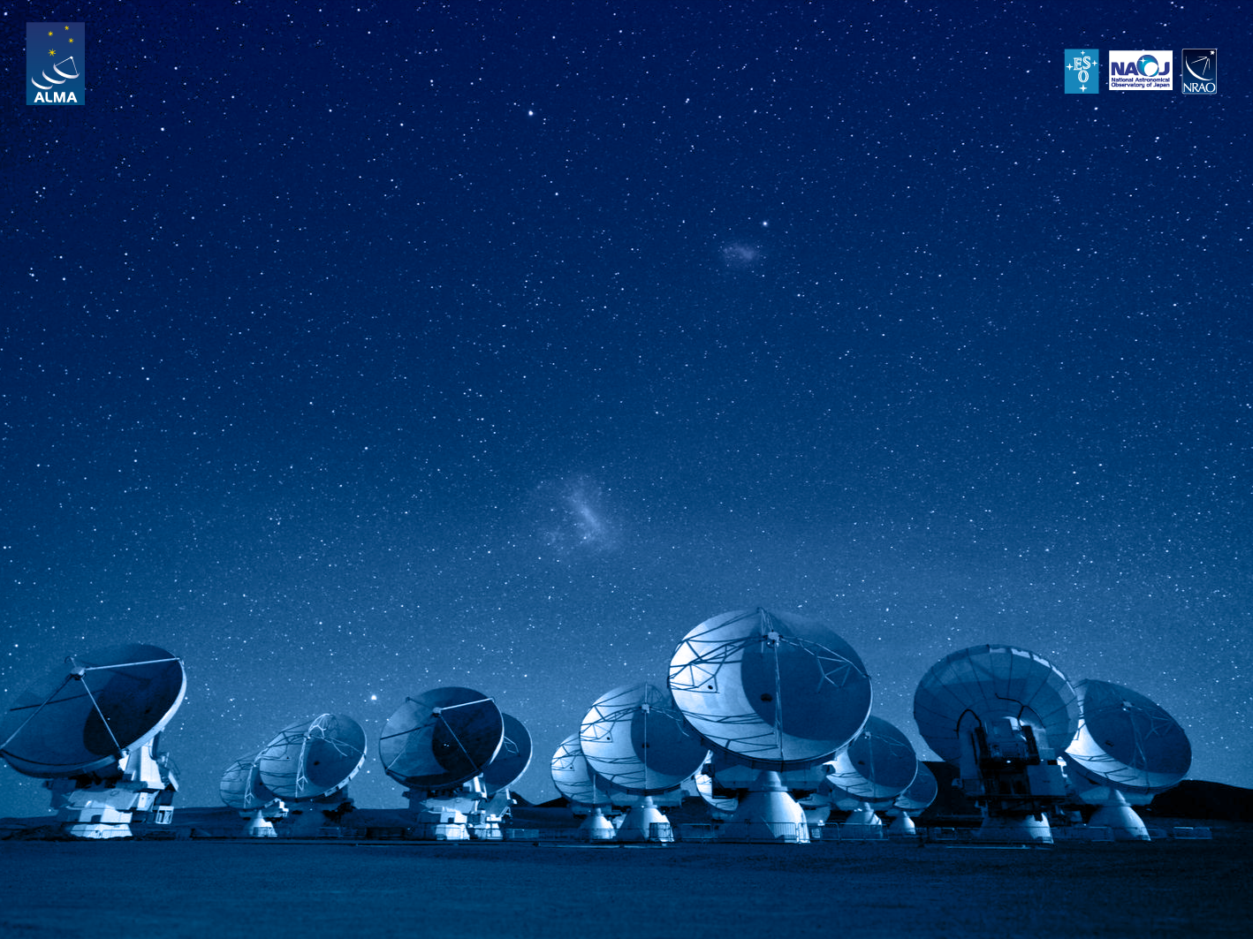
Descripción y Areas del Dpto. de Computación de ALMA (ADC)
Tzu-Chiang Shen
Gerente del Grupo de Software
Departamento de Computación ALMA
Joint ALMA Observatory

Slide 2
ADC’s Mission
To operate and maintain high-quality computing services in a safe and secure manner continuously improving the ALMA observatory by:
Having skilled and motivated staff
Maximizing the level of availability and reliability of the computing systems
Supporting ALMA stake holders
Collaborating with the technical community
Allowing ALMA to contribute to mankind’s knowledge by unveiling the mysteries of the universe.
Notes:
ACS provides the basic services needed for object oriented distributed computing using different programming languages. Among these are:
Transparent remote object invocation
Object deployment and location based on a container/component model
Distributed error and alarm handling
Distributed logging
Distributed events
The ACS framework is based on CORBA and built on top of free CORBA implementations.
Free software is extensively used wherever possible, to avoid “re-inventing the wheel”.
ACS itself is publicly available under the Lesser GNU Public License (LGPL) license 8
ACS’s primary platform is Red-Hat Enterprise Linux, but it works and is used also on other Linux variants.
Real time development is supported on Real Time Linux (for ALMA) and VxWorks (for other projects).
Development is supported in C++, Java and Python. Any other language with a CORBA mapping can be used, if needed. Coherent support of multiple programming languages is one of the key motivations for the implementation of ACS.

Slide 3
ADC’s Vision
To be recognized as a world-class reference in providing high-quality computing services for efficient astronomy data acquisition and delivery to the community.
To achieve this vision the department is committed to:
Train and motivate its members to provide high quality and secure services to ALMA staff, visitors and scientific community-at-large.
Operate, maintain, and continuously improve the observatory computing infrastructure and services to satisfy in full ALMA strategic goals

Slide 4
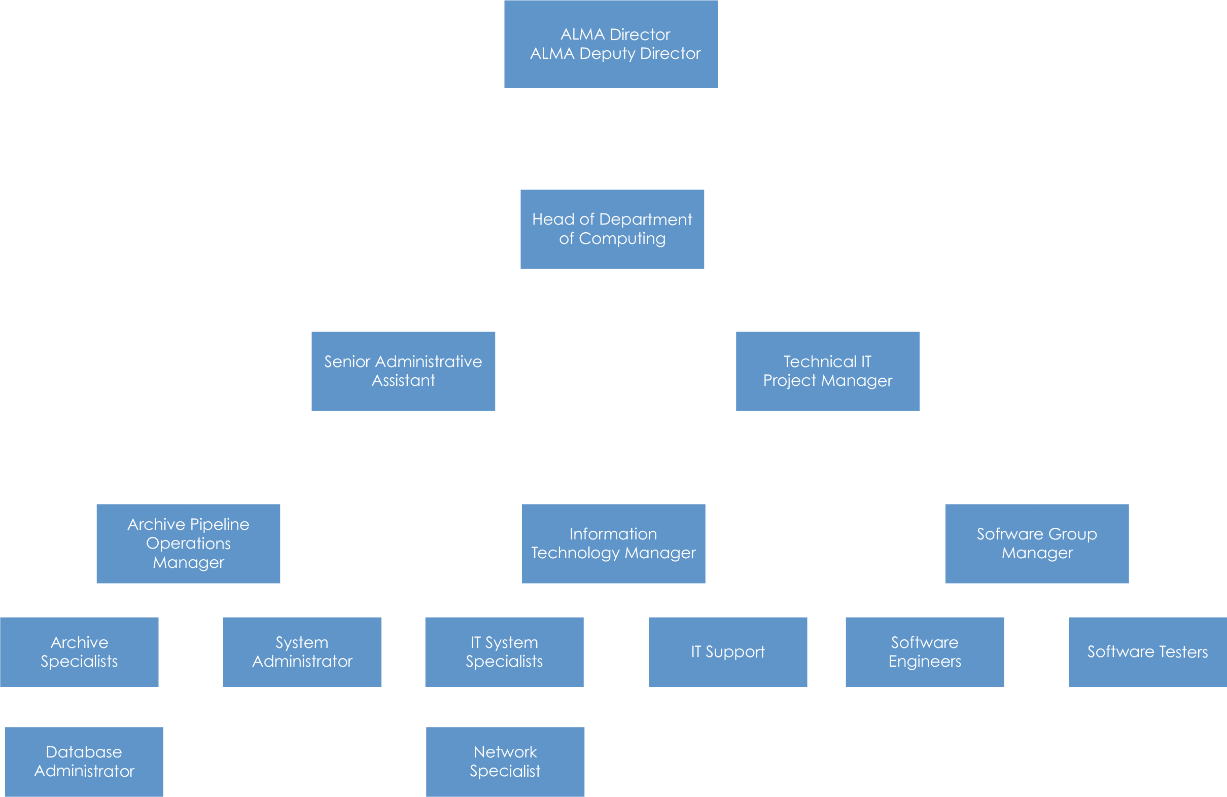
Organization
37 FTEs (2 ISM, 35 LSM)
~ 50% at OSF, 50% SCO
Notes:
A modern Observatory (or any other experimental facility) has a complex integrated and distributed architecture.
In the past, the Astronomer (the main stakeholder for our systems) was traveling to the Observatory, making his observations, storing data on tape and going back home to reduce it.
The telescope and, eventually, the instruments had a control system virtually independent from everything else.
Data reduction was done offline after the observation and there was no direct feedback from the observation data to the control system. An experienced observer was just driving the telescope based on his own feelings.
There was no observation data archive, no quality of service measures and constraints, no facility engineering in the terms we think of now.
This has dramatically changed in the past 20 years, with the big observatories like VLT, Keck, Gemini, Hubble and so on.
Since the major observatories are now providing integrated facilities, astronomers expect the same also from smaller ones and the amount of integration required for the new projects like ALMA and the giant optical telescopes like E-ELT, TMT or GMT will be even more. The Virtual Observatory is also contributing to this need for integration and quality control adding the intra-observatory dimension to the problem.
Now all the systems in an Observatory are fully integrated.
Observation data, weather and telemetry are directly fed back in the control system to obtain optimized performance.
The astronomer is in many cases not even any more going to the observatory, but monitors the observation from his own institute and can ideally interact with the system remotely when the observation is taking place.
The astronomer expects to interact with the system using “standard” Web technology.
Data is archived to be usable by Virtual Observatories and therefore has to contain calibration and quality information.
Engineers and people responsible for the administration and maintenance of the observatory are another important stakeholder. More and more performance is measured and telemetry information is analyzed daily to perform preventive maintenance and optimize the system or to measure performance trends over long time periods.
The new systems being designed now (like the ELTs) will need to coordinate the real time operation of devices distributed over large distances (hundreds of meters or even more). This is raising distributed control challenges to the next level.
Big projects are driving this evolution, but also small projects have to follow up in this direction to match the expectations of the observers. For them, the reduced budget makes it unaffordable to develop in-house integrated solutions. Many small projects are therefore interested in adopting solutions developed by other, bigger, ones.

Slide 5
IT Group
Manager: Christian Saldias
Responsibilities
Help desk
Networking services
Users network
Observing network
Backbone link administration.
General Services
email, VoIP, printers, backups, etc.
Server infrastructure
Blade servers administration
Servers virtualization

Slide 6
Archive Pipeline Operation Group
Manager: José Parra
Responsibility
ALMA Archive administration
Oracle Database administration
APDM, ASDM (metadata + binary data)
Database replication
Pipeline infrastructure administration
HPC administration

Slide 7
Software Group
Managers: Rubén Soto y Tzu-Chiang Shen
Responsibilities
ALMA Software Integration
Releases management
Releases testing
Support to Observatory Operation
Telescope Monitoring & Configuration Database
Operation Environments Configuration
Primary Faults Analysis
DevOps
Development to Support Operation

Slide 8
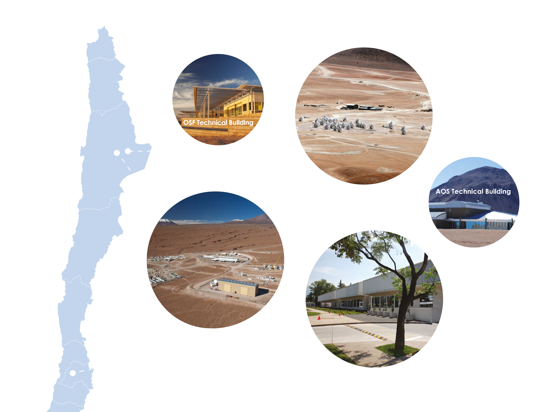
Joint ALMA Observatory

Slide 9
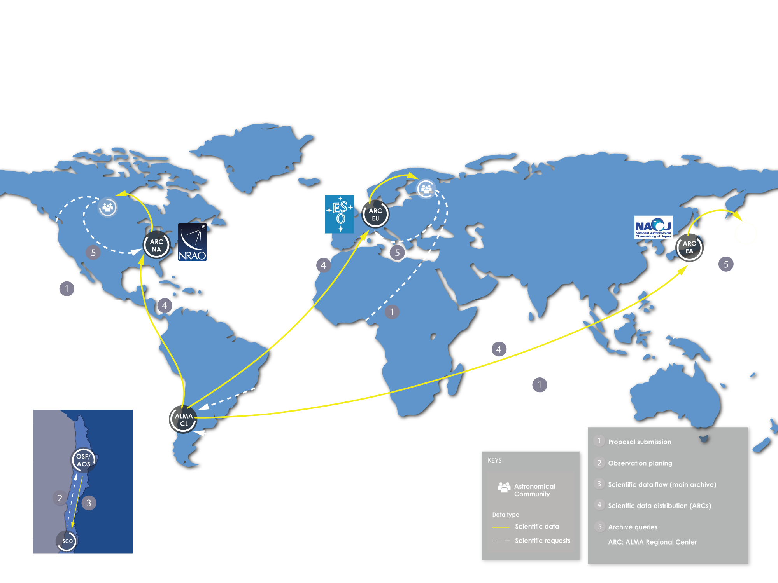


ALMA: Observatorio de clase mundial

Slide 10
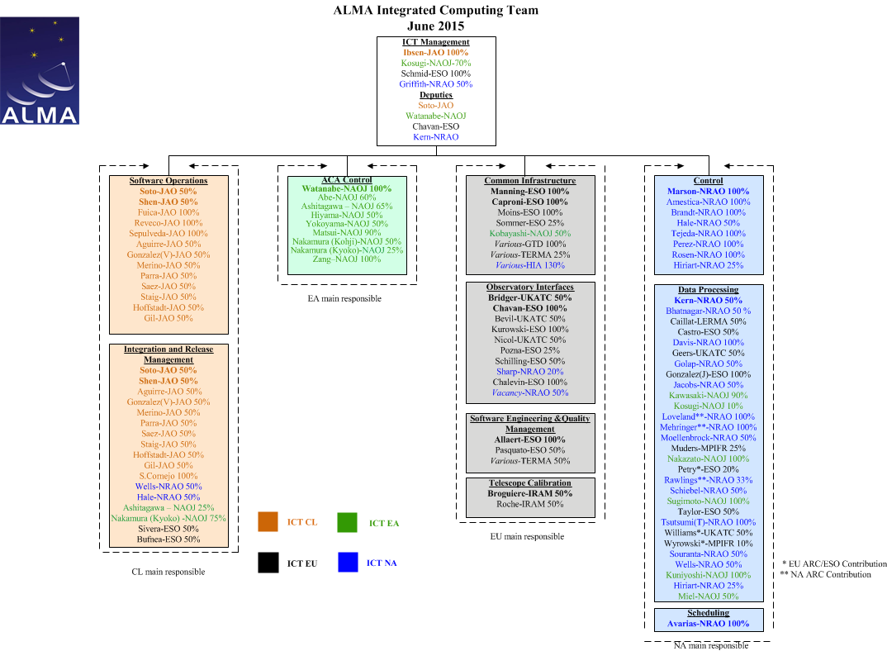

Slide 11
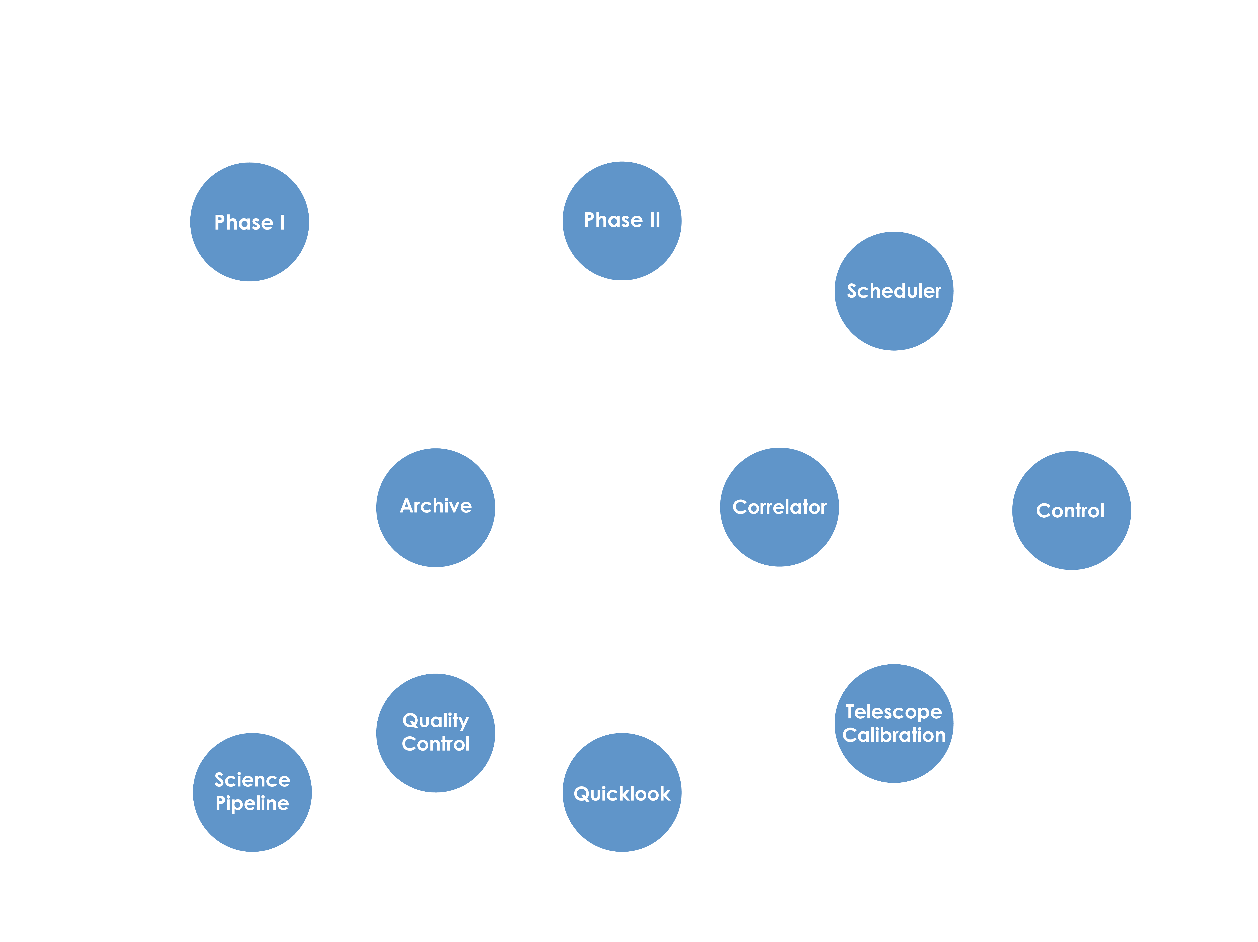
ALMA Dataflow
Notes:
Let’s take as an example a schematic architecture of the ALMA software (A.Farris, J.Schwarz ALMA HLA team).
This diagram shows the main subsystems in which the software has been divided and the main relationships among then in the form of a collaboration diagram describing the typical lifecycle of a project, starting with proposal submission and ending with a researcher looking for the data in the archive after the observation has been performed.

Slide 12
Colaboraciones Académicas y ALMA
Colaboraciones de largo plazo (formales e informales) con universidades chilenas desde el año 2006:
U. Técnica Federico Santa María, U. Chile, U. Católica del Norte, U. Bio-Bio, U. Católica, …
… y Universidad de la Frontera a partir de hoy!
(Un número significativo de) Prácticas de Verano desde el año 2006
(Un número significativo de) Memorias y Tésis de Grado desde el año 2007
Co-participación en proyectos CONICYT entre 2006 and 2010
Presencia visible en conferencia nacionales e internacionales: Astro-Engineering Workshop 2012 and 2013, Astroinformatics 2014, SPIE, ADASS, ICALEPS

Slide 13
Leading to Future Opportunities
Infrastructure development
Networks and data centers able to cope with transmission, storage and processing of massive data sets
Research in Astronomy, Computing Science, and Engineering
Astronomical Instrumentation
Real-time Control Systems
High volume data visualization and data mining
Network optimization
Remote Operations and Virtual Presence
Human Computer Interaction
And a number of topics for undergraduate diploma work

Slide 14
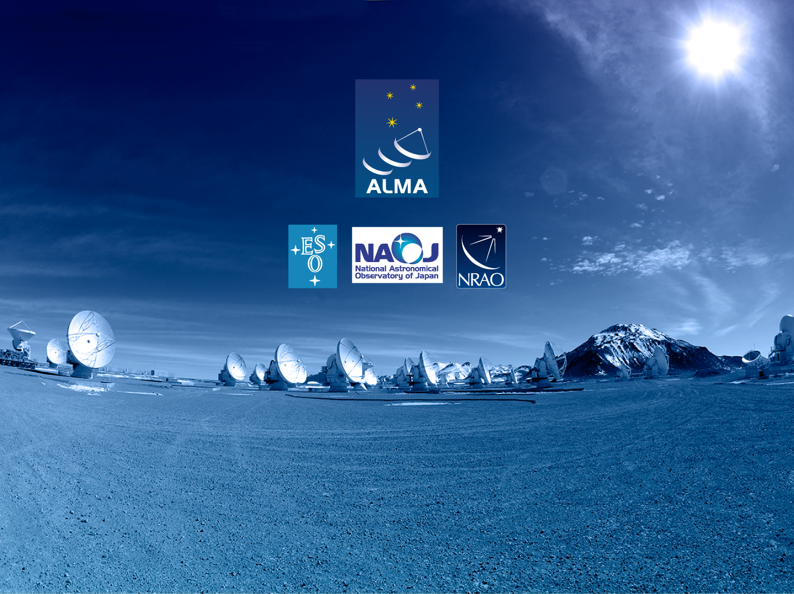
Muchas Gracias!
The Atacama Large Millimeter/submillimeter Array (ALMA), an international astronomy facility, is a partnership of Europe, North America and East Asia in cooperation with the Republic of Chile. ALMA is funded in Europe by the European Organization for Astronomical Research in the Southern Hemisphere (ESO), in North America by the U.S. National Science Foundation (NSF) in cooperation with the National Research Council of Canada (NRC) and the National Science Council of Taiwan (NSC) and in East Asia by the National Institutes of Natural Sciences (NINS) of Japan in cooperation with the Academia Sinica (AS) in Taiwan. ALMA construction and operations are led on behalf of Europe by ESO, on behalf of North America by the National Radio Astronomy Observatory (NRAO), which is managed by Associated Universities, Inc. (AUI) and on behalf of East Asia by the National Astronomical Observatory of Japan (NAOJ). The Joint ALMA Observatory (JAO) provides the unified leadership and management of the construction, commissioning and operation of ALMA.

